Slide 1

Multivariate random variables: modelling and simulation
Workshop 3
Teaching Assistant Anna Bubnova, Research Assistant

Slide 2
Key points
1. Inverse transform sampling
2. Rejecting sampling
3. Oriented probabilistic models
4. Bayesian networks

Slide 3
Learning objectives
The student will be able to distinguish between the types of sampling
2. The student will know what oriented probabilistic models are
3. The student will be able to train the structure and parameters of a Bayesian network on data of any type
4. The student will be able to write Python code for learning and sampling from Bayesian networks

Slide 4
Revising basics
Follow the link https://forms.gle/NaF5MYZrorTh36am6
You have 3 minutes

Slide 5

PDF, PMF, CDF
PDF, PMF, CDF

Slide 6
Probability Density Function
Let consider uniform random number generator [0,1].
Probability Density Function (PDF)

Slide 7
Probability Density Function
Let consider uniform random number generator [0,1].
Probability Density Function (PDF)

Slide 8
Probability Density Function
Let consider uniform random number generator [0,1].
Probability Density Function (PDF)

Slide 9
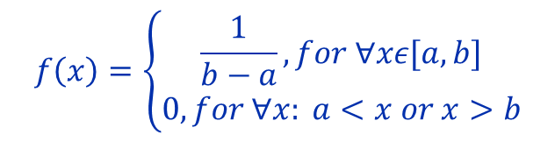
Probability Density Function
Let consider uniform random number generator [0,1].
Probability Density Function (PDF)
$$f\left(x\right)=\left\{\begin{aligned}\frac{1}{b−a}, for ∀xε[a,b] \\ 0,for ∀x: a<x or x>b\end{aligned}\right.$$

Slide 10
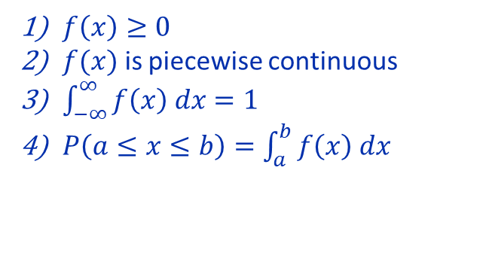
Probability Density Function
Let consider uniform random number generator [0,1].
Probability Density Function (PDF)
$$f\left(x\right)=\left\{\begin{aligned}\frac{1}{b−a}, for ∀xε[a,b] \\ 0,for ∀x: a<x or x>b\end{aligned}\right.$$
$f\left(x\right)≥0$
$f(x)$ is piecewise continuous
$\int_{−∞}^{∞}{f\left(x\right) dx}=1$
$P\left(a≤x≤b\right)=\int_{a}^{b}{f\left(x\right) dx}$

Slide 11

Probability Density Function
Let consider uniform random number generator [0,1].
Probability Density Function (PDF)
Probability Mass Function (PMF)
$$f\left(x\right)=\left\{\begin{aligned}\frac{1}{b−a}, for ∀xε[a,b] \\ 0,for ∀x: a<x or x>b\end{aligned}\right.$$
$f\left(x\right)≥0$
$f(x)$ is piecewise continuous
$\int_{−∞}^{∞}{f\left(x\right) dx}=1$
$P\left(a≤x≤b\right)=\int_{a}^{b}{f\left(x\right) dx}$

Slide 12
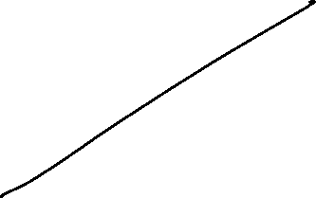

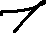
Probability Density Function
Let consider uniform random number generator [0,1].
Probability Density Function (PDF)
$$f\left(x\right)=\left\{\begin{aligned}\frac{1}{b−a}, for ∀xε[a,b] \\ 0,for ∀x: a<x or x>b\end{aligned}\right.$$
$$P\left(x≤0.2\right)$$
$f\left(x\right)≥0$
$f(x)$ is piecewise continuous
$\int_{−∞}^{∞}{f\left(x\right) dx}=1$
$P\left(a≤x≤b\right)=\int_{a}^{b}{f\left(x\right) dx}$

Slide 13
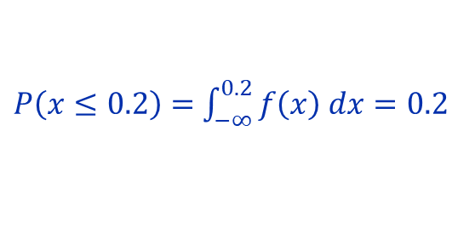
Probability Density Function
Let consider uniform random number generator [0,1].
Probability Density Function (PDF)
$$f\left(x\right)=\left\{\begin{aligned}\frac{1}{b−a}, for ∀xε[a,b] \\ 0,for ∀x: a<x or x>b\end{aligned}\right.$$
$P\left(x≤0.2\right)=$ $\int_{−∞}^{0.2}{f\left(x\right) dx}=0.2$
$f\left(x\right)≥0$
$f(x)$ is piecewise continuous
$\int_{−∞}^{∞}{f\left(x\right) dx}=1$
$P\left(a≤x≤b\right)=\int_{a}^{b}{f\left(x\right) dx}$

Slide 14
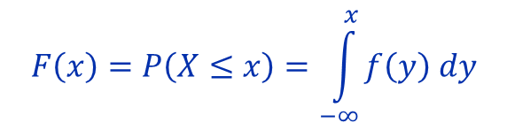
Cumulative Distribution Function
Let consider uniform random number generator [0,1].
Probability Density Function (PDF)
Cumulative Distribution Function (CDF)
$$F\left(x\right)=P\left(X≤x\right)=\int_{−∞}^{x}{f\left(y\right) dy}$$
$f\left(x\right)≥0$
$f(x)$ is piecewise continuous
$\int_{−∞}^{∞}{f\left(x\right) dx}=1$
$P\left(a≤x≤b\right)=\int_{a}^{b}{f\left(x\right) dx}$

Slide 15
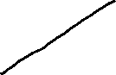
Cumulative Distribution Function
Let consider uniform random number generator [0,1].
Probability Density Function (PDF)
Cumulative Distribution Function (CDF)
$$F\left(x\right)=P\left(X≤x\right)=\int_{−∞}^{x}{f\left(y\right) dy}$$
$f\left(x\right)≥0$
$f(x)$ is piecewise continuous
$\int_{−∞}^{∞}{f\left(x\right) dx}=1$
$P\left(a≤x≤b\right)=\int_{a}^{b}{f\left(x\right) dx}$

Slide 16
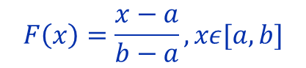
Cumulative Distribution Function
Let consider uniform random number generator [0,1].
Probability Density Function (PDF)
Cumulative Distribution Function (CDF)
$$F\left(x\right)=P\left(X≤x\right)=\int_{−∞}^{x}{f\left(y\right) dy}$$
$$F\left(x\right)=\frac{x−a}{b−a},xε[a,b]$$
$f\left(x\right)≥0$
$f(x)$ is piecewise continuous
$\int_{−∞}^{∞}{f\left(x\right) dx}=1$
$P\left(a≤x≤b\right)=\int_{a}^{b}{f\left(x\right) dx}$

Slide 17
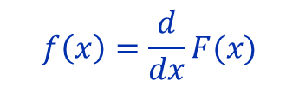
Cumulative Distribution Function
Let consider uniform random number generator [0,1].
Probability Density Function (PDF)
Cumulative Distribution Function (CDF)
$$F\left(x\right)=P\left(X≤x\right)=\int_{−∞}^{x}{f\left(y\right) dy}$$
$$F\left(x\right)=\frac{x−a}{b−a},xε[a,b]$$
$f\left(x\right)≥0$
$f(x)$ is piecewise continuous
$\int_{−∞}^{∞}{f\left(x\right) dx}=1$
$P\left(a≤x≤b\right)=\int_{a}^{b}{f\left(x\right) dx}$
$$f\left(x\right)=\frac{d}{dx}F(x)$$

Slide 18

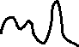
Sampling
Uniform random number generator [0,1]
Transformation
Any other distributions

Slide 19
Sampling
Uniform random number generator [0,1]
1) Inverse transform sampling
2) Accept-Reject sampling
3) Markov Chain Monte Carlo sampling
4) …
Transformation
Any other distributions

Slide 20
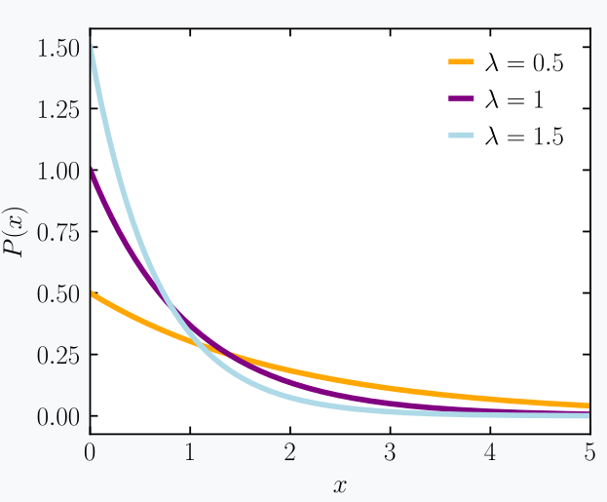
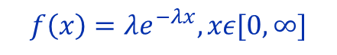

Inverse transform sampling
For example, let consider exponential distribution
$$f\left(x\right)=λe^{−λx}, xε[0,∞]$$
$$F\left(x\right)=$$

Slide 21

Inverse transform sampling
For example, let consider exponential distribution
$$f\left(x\right)=λe^{−λx}, xε[0,∞]$$
$$F\left(x\right)=P\left(X≤x\right)=\int_{0}^{x}{f\left(y\right) dy}=\int_{0}^{x}{λe^{−λy}dy}=$$

Slide 22
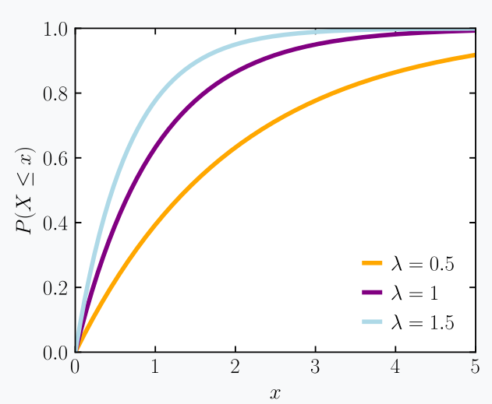
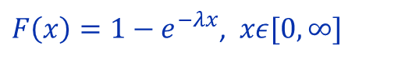

Inverse transform sampling
For example, let consider exponential distribution
$$f\left(x\right)=λe^{−λx}, xε[0,∞]$$
$$F\left(x\right)=P\left(X≤x\right)=\int_{0}^{x}{f\left(y\right) dy}=\int_{0}^{x}{λe^{−λy}dy}=$$
$$=λ\int_{0}^{x}{e^{−λy}dy}=λ\frac{−e^{−λy}}{λ}|_{0}^{x}=1−e^{−λx}$$
$F\left(x\right)=1−e^{−λx}$, $xε[0,∞]$

Slide 23



Inverse transform sampling
For example, let consider exponential distribution
$$f\left(x\right)=λe^{−λx}, xε[0,∞]$$
$$F\left(x\right)=P\left(X≤x\right)=\int_{0}^{x}{f\left(y\right) dy}=\int_{0}^{x}{λe^{−λy}dy}=$$
$$=λ\int_{0}^{x}{e^{−λy}dy}=λ\frac{−e^{−λy}}{λ}|_{0}^{x}=1−e^{−λx}$$
$F\left(x\right)=1−e^{−λx}$, $xε[0,∞]$

Slide 24
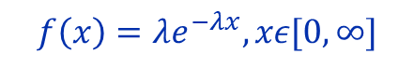
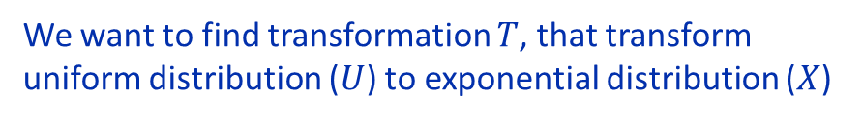
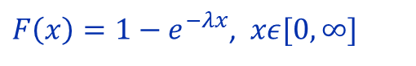
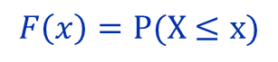
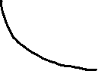
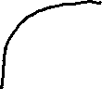
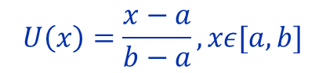
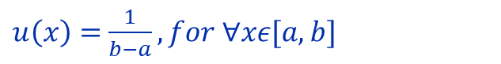

Inverse transform sampling
PDF
We want to find transformation $T$, that transform uniform distribution ($U$) to exponential distribution ($X$)
PDF
$$T\left(U\right)=X$$
$$F\left(x\right)=P(X≤x)$$
CDF
CDF
$u\left(x\right)=$ $\frac{1}{b−a}, for ∀xε[a,b]$
$$f\left(x\right)=λe^{−λx}, xε[0,∞]$$
$$U\left(x\right)=\frac{x−a}{b−a},xε[a,b]$$
$F\left(x\right)=1−e^{−λx}$, $xε[0,∞]$

Slide 25
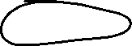
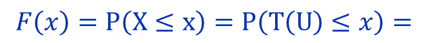
Inverse transform sampling
PDF
We want to find transformation $T$, that transform uniform distribution ($U$) to exponential distribution ($X$)
PDF
$$T\left(U\right)=X$$
$$F\left(x\right)=P\left(X≤x\right)=P\left(T\left(U\right)≤x\right)=$$
CDF
CDF
$u\left(x\right)=$ $\frac{1}{b−a}, for ∀xε[a,b]$
$$f\left(x\right)=λe^{−λx}, xε[0,∞]$$
$$U\left(x\right)=\frac{x−a}{b−a},xε[a,b]$$
$F\left(x\right)=1−e^{−λx}$, $xε[0,∞]$

Slide 26



Inverse transform sampling
PDF
We want to find transformation $T$, that transform uniform distribution ($U$) to exponential distribution ($X$)
PDF
$$T\left(U\right)=X$$
$$F\left(x\right)=P\left(X≤x\right)=P\left(T\left(U\right)≤x\right)=$$
CDF
$$=P\left(T^{−1}(T\left(U\right))≤T^{−1}(x)\right)=P\left(U≤T^{−1}(x)\right)$$
CDF
$u\left(x\right)=$ $\frac{1}{b−a}, for ∀xε[a,b]$
$$f\left(x\right)=λe^{−λx}, xε[0,∞]$$
$$U\left(x\right)=\frac{x−a}{b−a},xε[a,b]$$
$F\left(x\right)=1−e^{−λx}$, $xε[0,∞]$

Slide 27

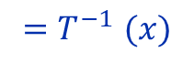
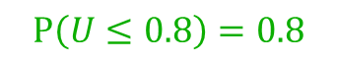
Inverse transform sampling
PDF
We want to find transformation $T$, that transform uniform distribution ($U$) to exponential distribution ($X$)
PDF
$$T\left(U\right)=X$$
$$F\left(x\right)=P\left(X≤x\right)=P\left(T\left(U\right)≤x\right)=$$
CDF
$$=P\left(T^{−1}(T\left(U\right))≤T^{−1}(x)\right)=P\left(U≤T^{−1}(x)\right)$$
CDF
$${=T}^{−1}(x)$$
$$P\left(U≤0.8\right)=0.8$$
$$F\left(x\right) {=T}^{−1}(x)$$
$$F^{−1}\left(x\right)=T(x)$$
$u\left(x\right)=$ $\frac{1}{b−a}, for ∀xε[a,b]$
$$f\left(x\right)=λe^{−λx}, xε[0,∞]$$
$$T\left(x\right)=F^{−1}\left(x\right)$$
$$U\left(x\right)=\frac{x−a}{b−a},xε[a,b]$$
$F\left(x\right)=1−e^{−λx}$, $xε[0,∞]$

Slide 28
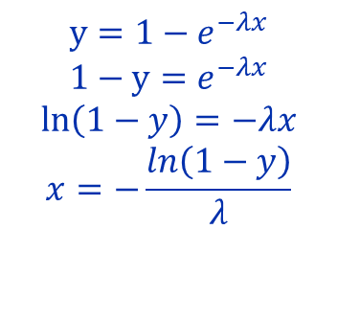
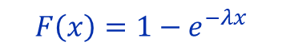
Inverse transform sampling
$$T\left(x\right)=F^{−1}\left(x\right)$$
$$F\left(x\right)=1−e^{−λx}$$
$$y=1−e^{−λx}$$
$$1−y=e^{−λx}$$
$$\ln\left(1−y\right)=−λx$$
$$x=−\frac{ln\left(1−y\right)}{λ}$$
$$f\left(x\right)=λe^{−λx}, xε[0,∞]$$
$F\left(x\right)=1−e^{−λx}$, $xε[0,∞]$

Slide 29
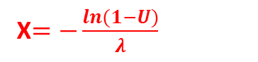
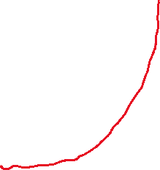

Inverse transform sampling
$$T\left(x\right)=F^{−1}\left(x\right)$$
$$F\left(x\right)=1−e^{−λx}$$
$$y=1−e^{−λx}$$
$$1−y=e^{−λx}$$
$$\ln\left(1−y\right)=−λx$$
$$x=−\frac{ln\left(1−y\right)}{λ}$$
X$=−\frac{ln(1−U)}{λ}$
$$f\left(x\right)=λe^{−λx}, xε[0,∞]$$
$F\left(x\right)=1−e^{−λx}$, $xε[0,∞]$

Slide 30
Inverse transform sampling
Output
Exponential distribution
Input
Uniform distribution

Slide 31
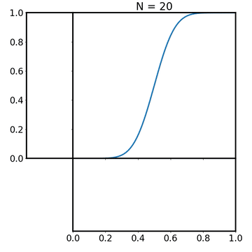
Inverse transform sampling
Pros:
100% efficient
Cons:
You should have CDF of distribution
You should can calculate inverse CDF (ICDF)
Normal distribution

Slide 32
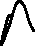
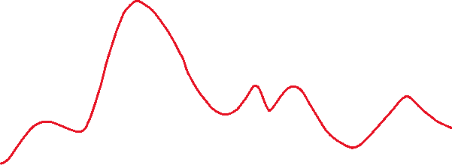
Inverse transform sampling
PDF
CDF

Slide 33
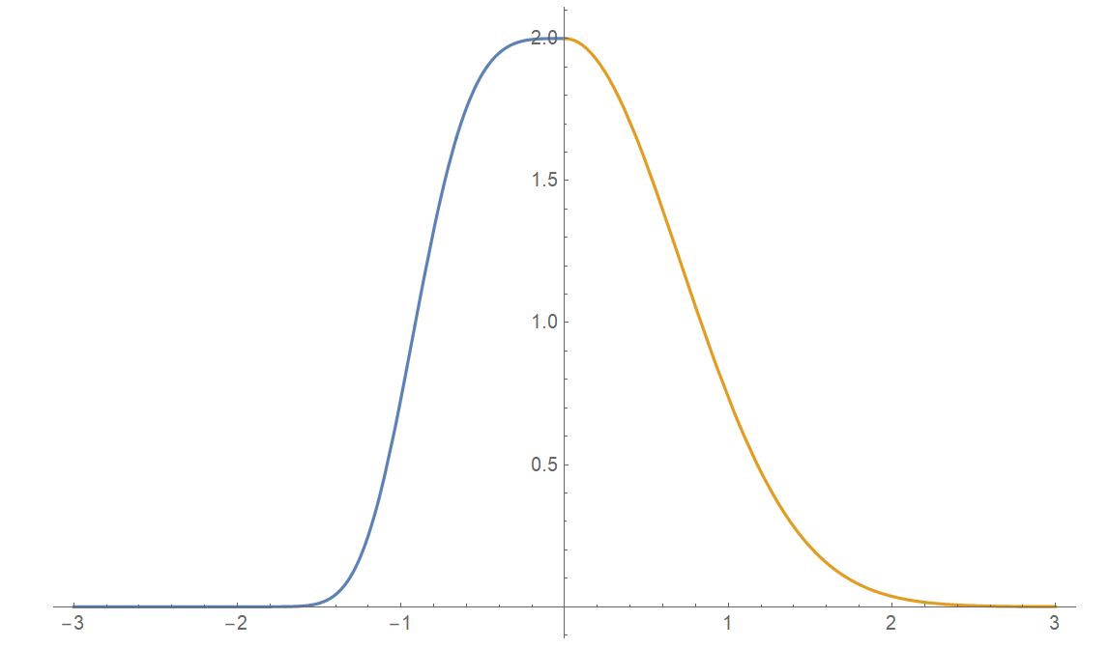
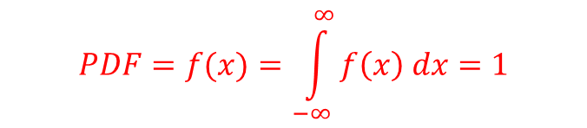
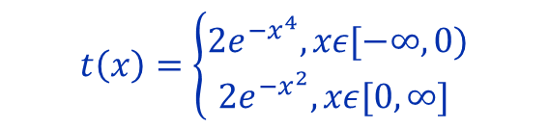
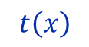
Accept-Reject sampling
$$t\left(x\right)=\left\{\begin{aligned}2e^{−x^{4}}, xε[−∞,0) \\ {2e}^{{−x}^{2}}, xε[0,∞] \end{aligned}\right.$$
$$t\left(x\right)$$
$$PDF=f(x)=\int_{−∞}^{∞}{f\left(x\right) dx}=1$$

Slide 34
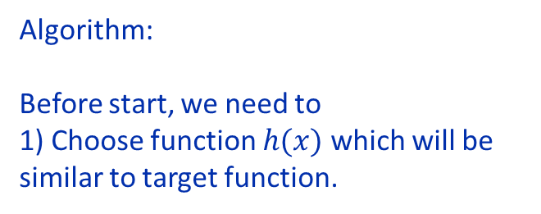
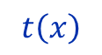
Accept-Reject sampling
Algorithm:
Before start, we need to
1) Choose function $h(x)$ which will be similar to target function.
$$t\left(x\right)$$

Slide 35
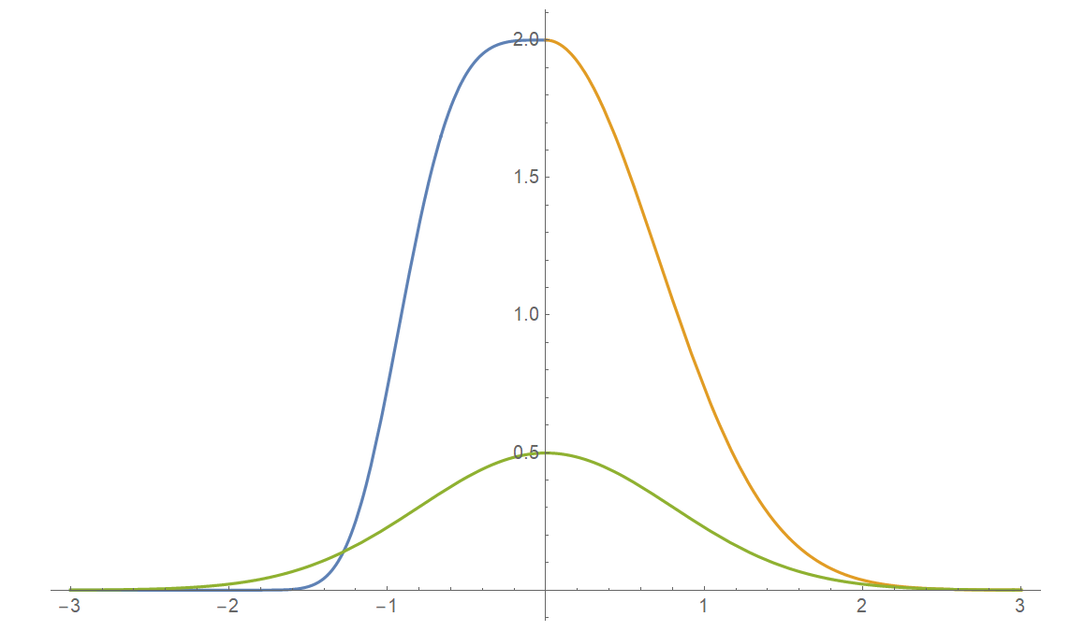
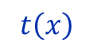
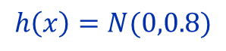
Accept-Reject sampling
Algorithm:
Before start, we need to
1) Choose function $h(x)$ which will be similar to target function.
$$t\left(x\right)$$
$$h\left(x\right)=N(0,0.8)$$

Slide 36
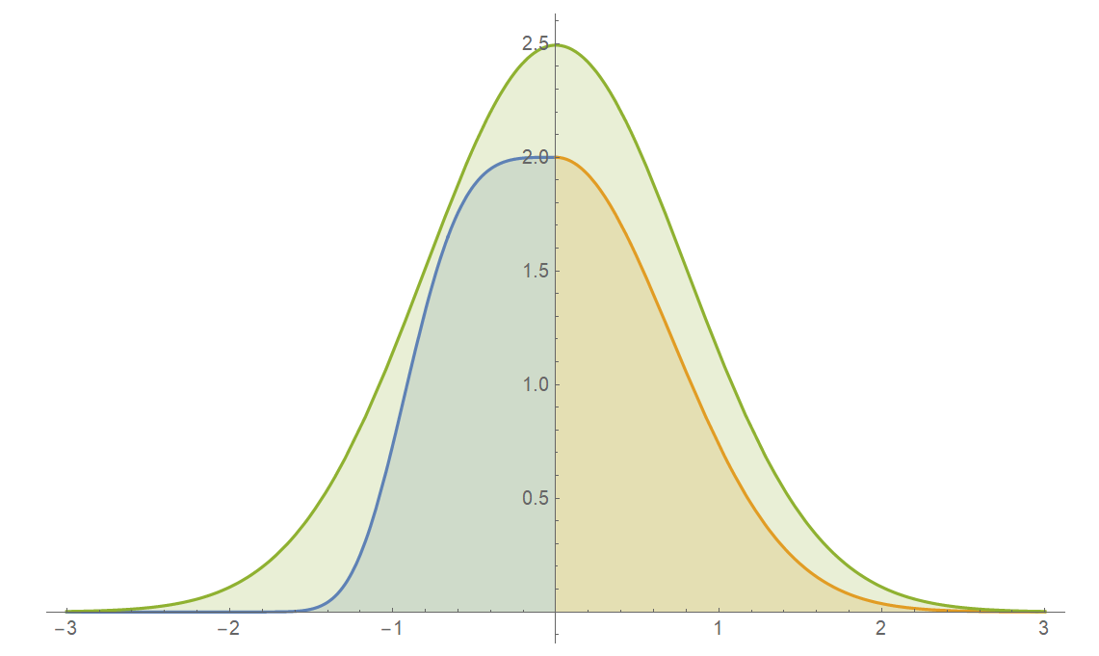
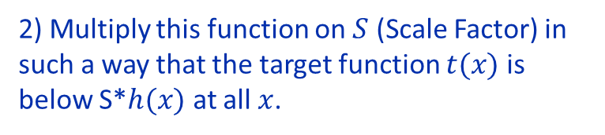
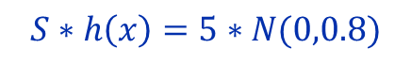
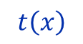
Accept-Reject sampling
$$S∗h\left(x\right)=5∗N(0,0.8)$$
Algorithm:
Before start, we need to
1) Choose function $h(x)$ which will be similar to target function.
$$t\left(x\right)$$
2) Multiply this function on $S$ (Scale Factor) in such a way that the target function $t(x)$ is below S*$h(x)$ at all $x$.

Slide 37
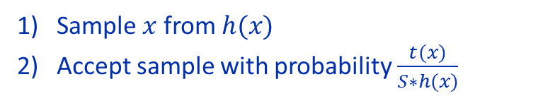
Accept-Reject sampling
$$S∗h\left(x\right)=5∗N(0,0.8)$$
Algorithm:
Before start, we need to
1) Choose function $h(x)$ which will be similar to target function.
$$t\left(x\right)$$
2) Multiply this function on $S$ (Scale Factor) in such a way that the target function $t(x)$ is below S*$h(x)$ at all $x$.
2 step:
Sample $x$ from $h(x)$
Accept sample with probability $\frac{t(x)}{S∗h(x)}$

Slide 38
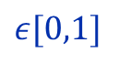
Accept-Reject sampling
$$S∗h\left(x\right)=5∗N(0,0.8)$$
Algorithm:
Before start, we need to
1) Choose function $h(x)$ which will be similar to target function.
$$t\left(x\right)$$
2) Multiply this function on $S$ (Scale Factor) in such a way that the target function $t(x)$ is below S*$h(x)$ at all $x$.
2 step:
Sample $x$ from $h(x)$
Accept sample with probability $\frac{t(x)}{S∗h(x)}$
$$ε[0,1]$$

Slide 39
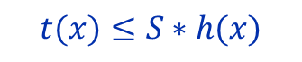
Accept-Reject sampling
$$S∗h\left(x\right)=5∗N(0,0.8)$$
Algorithm:
Before start, we need to
1) Choose function $h(x)$ which will be similar to target function.
$$t\left(x\right)$$
2) Multiply this function on $S$ (Scale Factor) in such a way that the target function $t(x)$ is below S*$h(x)$ at all $x$.
2 step:
Sample $x$ from $h(x)$
Accept sample with probability $\frac{t(x)}{S∗h(x)}$
$$ε[0,1]$$
$$t(x)≤S∗h(x)$$

Slide 40
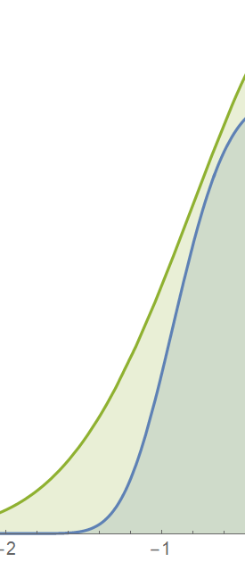






Accept-Reject sampling
$$S∗h\left(x\right)=5∗N(0,0.8)$$
Accept stack: $x_{1}$, …
Reject stack:
$$t\left(x\right)$$
$$x_{1}$$
Sample $x$ from $h(x)$
Accept sample with probability $\frac{t(x)}{S∗h(x)}$
$$x_{1}$$

Slide 41






Accept-Reject sampling
$$f(x)=\frac{t(x)}{NC}$$
$$S∗h\left(x\right)=5∗N(0,0.8)$$
Accept stack: $x_{1}$, …
Reject stack: $x_{2}$, …
$$t\left(x\right)$$
$$x_{2}$$
$$x_{1}$$
Sample $x$ from $h(x)$
Accept sample with probability $\frac{t(x)}{S∗h(x)}$
$$x_{2}$$
$$x_{1}$$

Slide 42


Accept-Reject sampling
$$S∗h\left(x\right)=5∗N(0,0.8)$$
It turns out that accept stack: $x_{1},x_{3}$, … is sampled from … $f(x)$
$$t\left(x\right)$$
We don’t know $f(x)$
We don’t know CDF and ICDF $F\left(x\right)$
But we can sampling from it!!!
Sounds like a magic.
Sample $x$ from $h(x)$
Accept sample with probability $\frac{t(x)}{S∗h(x)}$

Slide 43





Accept-Reject sampling
Cons:
Difficulties of choosing $h\left(x\right)$
Big $S$ -> small $P(Accepted)$ -> large computation time

Slide 44
Multivariate random variables

Slide 45

Multivariate distribution estimation
Motivation. Imagine, you need to estimate multivariate probability distribution for large amount of variables
X = (X1, X2, X3)
At the same time, it is very difficult describe this distribution by a single multivariate theoretical distribution.
To do this, usually one can take the following steps:
-divide the multivariate distribution into the product of the factor distributions and evaluate these distributions individually (factorization);
f(X1,X2,X3) = f(X1|X2,X3)f(X2|X3)f(X3)
-assume presence of independent and conditionally independent factors for dimension reduction of the task.
Notes:
Animation 1. So, first we need to read the data from a text file. The file itself is a set of about one and a half thousand floating point values. In MATLAB, opening and reading a file can be done using the dlmread function, which takes the name of the file as an argument. The result is stored in the ‘waves’ array. Then, to further model the distribution, we need a point estimate of the parameters of this distribution. To find it, we use the function mle, which implements the maximum likelihood method. This function returns the values of the point estimates of the distribution law parameters. The distribution type is set to the string variable 'dist' in accordance with the following table. The sample of observations is determined by the vector variable data. The results of the parameter evaluation can be output to the console using the ‘display’ function, and it is also convenient to visualize with the help of the scatter function, which draws a quantile biplot. Animation 2.
Animation 3. And at the end, in order to compare the initial distribution and distribution with the estimated parameters, we can construct two graphs using the functions ksdensity and wblpdf.

Slide 46




Conditional Independence
$$x⊥y | z$$
vs
$$x⊥y$$
$$p\left(x,y|z\right)=p\left(x|z\right)p(y|z)$$
In other words, all information about the interdependencies between x and y is contained in z
Note that conditional independence does not follow from unconditional independence and vice versa
Height
hair length

Slide 47
Conditional Independence
$$x⊥y | z$$
vs
$$x⊥y$$
$$p\left(x,y|z\right)=p\left(x|z\right)p(y|z)$$
In other words, all information about the interdependencies between x and y is contained in z
Note that conditional independence does not follow from unconditional independence and vice versa
?
Height
hair length

Slide 48

Conditional Independence
$$x⊥y | z$$
vs
$$x⊥y$$
$$p\left(x,y|z\right)=p\left(x|z\right)p(y|z)$$
In other words, all information about the interdependencies between x and y is contained in z
Note that conditional independence does not follow from unconditional independence and vice versa
Sex
Height
hair length

Slide 49
Conditional Independence
$$x⊥y | z$$
vs
$$x⊥y$$
$$p\left(x,y|z\right)=p\left(x|z\right)p(y|z)$$
In other words, all information about the interdependencies between x and y is contained in z
Note that conditional independence does not follow from unconditional independence and vice versa
Battle
IQ
Test
Grade
Rome
Imperator

Slide 50
Conditional Independence
$$x⊥y | z$$
vs
$$x⊥y$$
$$p\left(x,y|z\right)=p\left(x|z\right)p(y|z)$$
In other words, all information about the interdependencies between x and y is contained in z
Note that conditional independence does not follow from unconditional independence and vice versa
Battle
IQ
Test
Grade
Rome
Imperator

Slide 51


Multivariate distribution estimation
Factorization involves the decomposition of a multivariate distribution function (or density) into the product of conditional distributions:
$$f\left(x_{1},...,x_{n}\right)=f(x_{1})\prod_{i=2}^{n}{f(x_{i}|x_{1},…,x_{i−1})}$$
In order to simplify and understand logic, you can add a chain rule.
$f\left(x_{1},x_{2},x_{3}\right)=f\left(x_{1} | x_{2},x_{3}\right)f(x_{2},x_{3})$,
$f\left(x_{2},x_{3}\right)=$ $f\left(x_{2}|x_{3}\right)f(x_{3})$,
$$f\left(x_{1},x_{2},x_{3}\right)=f\left(x_{1} | x_{2},x_{3}\right)f\left(x_{2}|x_{3}\right)f\left(x_{3}\right).$$
Also you need to define conditional independence.
$x_{1}$ and $x_{2}$ are independent $x_{3}$- ${ x_{1}⊥x}_{2}|x_{3}$, if:
$$f\left(x_{1},x_{2}{|x}_{3}\right)= f\left(x_{1}{|x}_{3}\right)f\left(x_{2}{|x}_{3}\right).$$
With full independence of$x_{1}$ and $x_{2}$ - ${ x_{1}⊥x}_{2}$, it is possible to write down joint distribution as:
$$f\left(x_{1},x_{2},x_{3}\right)= f\left(x_{1}{|x}_{3}\right)f\left(x_{3}\right)f\left(x_{2}\right).$$

Slide 52




Structured probabilistic models
The presence of conditionally independent factors can significantly reduce the cost of calculating the multivariate distribution estimate, since the number of parameters of each factor distribution is exponentially dependent on its dimension.
With sparse representation of the multivariate distribution, it can be conveniently described as a graphic or structural probability model.
Oriented models:
Non-oriented models:
x1
x2
x1
x2
$p\left(X\right)=\prod_{i}{p(x_{i}|x_{1},…,x_{i−1})}$
$${ x_{1}⊥x}_{4}|x_{3}$$
x3
Graph clique
x3
$p\left(X\right)=\frac{1}{Z}\prod_{i}{φ_{i}(𝒞_{i})}$
x4
x5
x4
x5
Probabilistic writing:
Functional writing:
$$p\left(x_{1},…,x_{5}\right)=p\left(x_{1}\right)p\left({x_{2}|x}_{1}\right)×…$$
$…×p\left({x_{3}|x}_{1},x_{2}\right)p({x_{4}|x}_{3})$ $p({x_{5}|x}_{3},x_{4})$
$p\left(x_{1},…,x_{5}\right)=\frac{1}{Z}φ_{1}(x_{1},x_{3})$ $φ_{2}(x_{2},x_{3})φ_{2}(x_{3},x_{4},x_{5})$

Slide 53

Problems of initial multivariate distribution estimation
Imagine you have N random variable. For simplicity, let them be discrete, each taking K values.
Therefore, if you need to estimate the joint density of the distribution, while solving the task explicitly, you need to estimate the values in the sheet with the number of cells $K^{N}$.
$$N=2, K=100 →R=K^{N}={10}^{4}$$
$$N=100, K=100 →R=K^{N}={10}^{200}$$
…
For the same reason, other aspects of working with such models are also difficult:
- the statistical efficiency of the distribution approximation is reduced, the model tends to over-training, since it is not possible to find a sufficiently large training sample for such a model;
the complexity of a statistical conclusion can be estimated as $O\left(K^{N}\right);$
at worst, the complexity of generation from the received distribution (or model sample) has an order of $O\left(K^{N}\right)$ as well.
In other words, the amount of memory needed to store these values is growing exponentially!

Slide 54


Oriented probabilistic models
From the probabilistic point of view, natural representation of factorization is belief network or Bayesian network.
Example:
There is a group of 6 students who perform interconnected course projects. What is the joint probability of students getting a score of 1 to 5?
In an explicit approach to this task, you must calculate $5^{6}$=15625 values of joint probabilities. However, considering the information that students have divided into teams and therefore only part of the course projects have a relationship, it will be possible to reduce the dimension of this task.
Structural-based joint distribution estimation:
Team 1
a1
a2
$$p\left(a,b\right)=p\left(a\right)p\left(b\right)=p\left(a1\right)p\left(a2 | a1\right)p\left(a3 | a2\right)p\left(b1\right)p\left(b2\right)p(b3|b1,b2)$$
a3
Memory complexity:
b1
$$R=5+25+25+5+5+125=190$$
Team 2
b3
Benefits using structural-based approach:
b2
$$R^{full}/R≈80$$

Slide 55


Bayesian network – Simple example
The graphical structure can be built one node at a time with pre-initialized distributions set for each node .
(2) Both the graphical structure and distributions can be learned directly from data.
Let’s look at initializing a Bayesian network in the first manner by quickly implementing the Monty Hall problem.
Open file BN1.ipynb
https://pomegranate.readthedocs.io/en/latest/index.html
Notes:
Animation 1. So, first we need to read the data from a text file. The file itself is a set of about one and a half thousand floating point values. In MATLAB, opening and reading a file can be done using the dlmread function, which takes the name of the file as an argument. The result is stored in the ‘waves’ array. Then, to further model the distribution, we need a point estimate of the parameters of this distribution. To find it, we use the function mle, which implements the maximum likelihood method. This function returns the values of the point estimates of the distribution law parameters. The distribution type is set to the string variable 'dist' in accordance with the following table. The sample of observations is determined by the vector variable data. The results of the parameter evaluation can be output to the console using the ‘display’ function, and it is also convenient to visualize with the help of the scatter function, which draws a quantile biplot. Animation 2.
Animation 3. And at the end, in order to compare the initial distribution and distribution with the estimated parameters, we can construct two graphs using the functions ksdensity and wblpdf.

Slide 56
Bayesian network – Simple example
The graphical structure can be built one node at a time with pre-initialized distributions set for each node .
(2) Both the graphical structure and distributions can be learned directly from data.
Let’s look at initializing a Bayesian network in the first manner by quickly implementing the Monty Hall problem.
Open file BN1.ipynb
https://pomegranate.readthedocs.io/en/latest/index.html
Notes:
Animation 1. So, first we need to read the data from a text file. The file itself is a set of about one and a half thousand floating point values. In MATLAB, opening and reading a file can be done using the dlmread function, which takes the name of the file as an argument. The result is stored in the ‘waves’ array. Then, to further model the distribution, we need a point estimate of the parameters of this distribution. To find it, we use the function mle, which implements the maximum likelihood method. This function returns the values of the point estimates of the distribution law parameters. The distribution type is set to the string variable 'dist' in accordance with the following table. The sample of observations is determined by the vector variable data. The results of the parameter evaluation can be output to the console using the ‘display’ function, and it is also convenient to visualize with the help of the scatter function, which draws a quantile biplot. Animation 2.
Animation 3. And at the end, in order to compare the initial distribution and distribution with the estimated parameters, we can construct two graphs using the functions ksdensity and wblpdf.

Slide 57

Bayesian network – Simple example
The graphical structure can be built one node at a time with pre-initialized distributions set for each node .
(2) Both the graphical structure and distributions can be learned directly from data.
Let’s look at initializing a Bayesian network in the first manner by quickly implementing the Monty Hall problem.
The graph has three nodes, each representing the door chosen by:
The door selected by the Guest
The door containing the prize (car)
The door Monty chooses to open
Open file BN1.ipynb
https://pomegranate.readthedocs.io/en/latest/index.html
Notes:
Animation 1. So, first we need to read the data from a text file. The file itself is a set of about one and a half thousand floating point values. In MATLAB, opening and reading a file can be done using the dlmread function, which takes the name of the file as an argument. The result is stored in the ‘waves’ array. Then, to further model the distribution, we need a point estimate of the parameters of this distribution. To find it, we use the function mle, which implements the maximum likelihood method. This function returns the values of the point estimates of the distribution law parameters. The distribution type is set to the string variable 'dist' in accordance with the following table. The sample of observations is determined by the vector variable data. The results of the parameter evaluation can be output to the console using the ‘display’ function, and it is also convenient to visualize with the help of the scatter function, which draws a quantile biplot. Animation 2.
Animation 3. And at the end, in order to compare the initial distribution and distribution with the estimated parameters, we can construct two graphs using the functions ksdensity and wblpdf.

Slide 58
Problems
No expertise - it is necessary to train the network structure
No distributions in nodes - it is necessary to train distribution parameters in nodes;
Work both with categorical, discrete and continuous data;
Skips in data.

Slide 59
Structural learning
Algorithms of learning structure
Constraint-based
Score-based
Score-functions:
Mutual information;
K2;
Bdeu;
BIC;
AIC.
Search strategies:
Hill-Climbing;
Exhaustive search;
Evolutionary algorithms.

Slide 60

Structural learning
Algorithms of learning structure
Constraint-based
Score-based
Score-functions:
Mutual information;
K2;
Bdeu;
BIC;
AIC.
Search strategies:
Hill-Climbing;
Exhaustive search;
Evolutionary algorithms.

Slide 61
Greedy heuristics
Step 1:
Initialize the network as the empty network.
Step 4:
Repeat step 3 until the score does not improve.
Step 2:
Randomly select a permutation π: {1,…, |X|} → X.
Step 5:
Repeat steps 1 through 4 for n times and return the best solution found in these iterations.
Step 3:
For all i = I, …, |X|, do the following two steps:
A:
Compute the changes of the score when adding a new parent for π(i) or removing or reversing the edge of a parent gene of π(i).
B:
Select the modification among the modifications that improve the score most without violating the acyclicity condition.

Slide 62



Training parameters
For discrete distributions– table CPD
Suppose we have a node X and its parents U. Then MLE rating parameters will be:
$\hat{θ_{X|U}}$ = $\frac{M[U,X]}{M[U]}$,
где M[U] = $\sum_{X}{M\left[U,X\right].}$

Slide 63

Training parameters
For continuous distributions – Gaussian mixture
Suppose we have a node X and its parents U. Then MLE rating parameters will be: $P\left(X \right|U)=N(β_{0}+ β_{1}U1+ …+β_{k}Uk, σ^{2}$)

Slide 64


Training parameters
Continuous variable, Continuous parents
IQ
Test

Slide 65


Training parameters
Continuous variable, Continuous parents
Continuous variable, Discrete parents
IQ
Visiting
IQ
Test
Test

Slide 66

Parameters learning

Slide 67















Sample from oriented models
Ancestral sampling – sampling from an oriented model based on topological sorting of graph nodes, ensuring that sampling from ancestor nodes will be done earlier than from child nodes.
Let's consider the principle of work of ancestral sample on the example of the Bayesian graph of one of the teams of students ​
Using model of MRV:
$$p\left(a1\right)$$
$$p\left(a2 | a1\right)$$
$$p\left(a3 | a2\right)$$
$$p\left(a\right)=p\left(a1\right)p\left(a2 | a1\right)p\left(a3 | a2\right)$$
Team 1
a1
a2
a3
Repeat N times the following steps:
Step 1. Generate random value ${a1}_{(i)}$ using Monte Carlo method from distribution $p\left(a1\right)$.
Step 2. Generate random value ${a2}_{(i)}$ from distribution $p\left(a2 | {a1}_{(i)}\right).$
Step 3. Generate random value ${a3}_{(i)}$ from distribution $p\left(a3 | {a2}_{(i)}\right).$
[1x5]
[5x5]
[5x5]
$${\left[\begin{matrix}.05 \\ .15 \\ .2 \\ .35 \\ .25\end{matrix}\right]}^{T}$$
$$a2$$
$$a2$$
$$a1$$
$$\left[\begin{matrix}.06 & ⋯ & .0001 \\ ⋮ & ⋱ & ⋮ \\ 0.005 & ⋯ & .1\end{matrix}\right]$$
$$\left[\begin{matrix}.05 & ⋯ & .0002 \\ ⋮ & ⋱ & ⋮ \\ 0.006 & ⋯ & .08\end{matrix}\right]$$
$$a1$$
$$a3$$
Start
$${a1}_{(5)}$$
$${a2}_{(5)}$$
$${a3}_{(4)}$$
Your random value is ready!
Your random variable or sample from the model is ready!
$${{a_{j}=[a1}_{(5)},{a2}_{(5)},{a3}_{(4)}]}_{j}, j=1…N$$

Slide 68


Python packs
https://pomegranate.readthedocs.io/en/latest/index.html
https://pgmpy.org/
BAMT
https://github.com/ITMO-NSS-team/BAMT

Slide 69
Bayesian Network on real data
Now we have real VKontakte data containing age, gender, city code, education, relationship status and Geo data.
It is necessary to train the Bayesian network parameters directly from this data.
It is also necessary to sample data from the resulting joint distribution structure.
Open file Socio.ipynb
Open file Geo.ipynb
Open BAMT/Example/Mixed Learning.ipynb

